Slide 1
The Seal’s Lesson on Stats
October 12,2016

Slide 2
What is Statistics:
Classified facts representing the conditions of a people in a state-especially the facts that can be stated in numbers or any tabular (table) or classified arrangement
Examples are census, polls, sports, grades, scientific experiments, and weather.

Slide 3
What is Statistics:
Is a way to use math to study our world and to make decisions.
What should I wear today?
Will I need an umbrella?
Will I need a jacket?

Slide 4
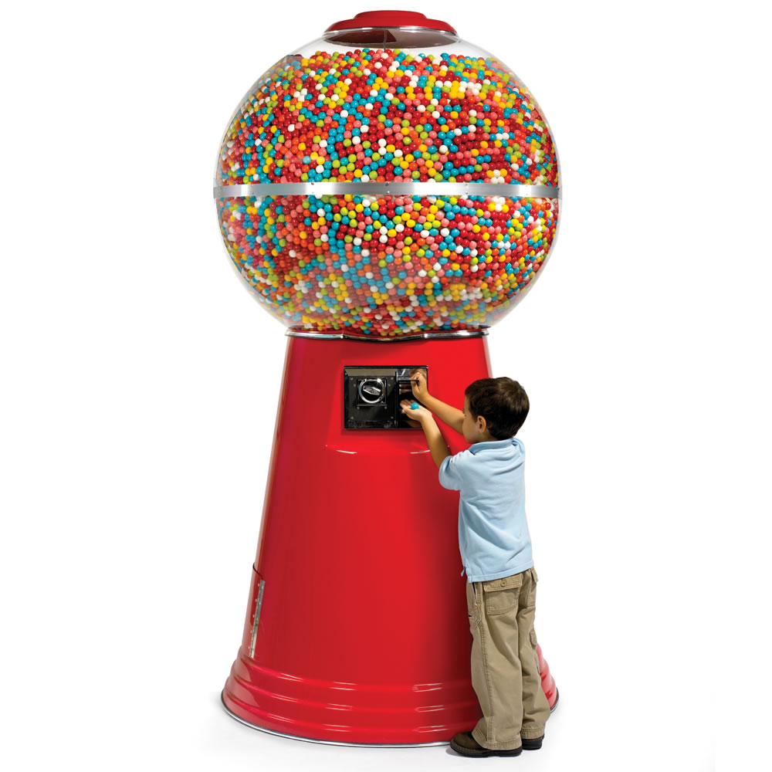
Gumball Wizard :<
Imagine a gumball machine where every time you took 1 gumball of a certain color, the gumball wizard would replace a gumball of the same color.

Slide 5
Gumball wizard experiment
We’re going to conduct an experiment with a smaller “gumball machine.” Our experiment will have 10 gumballs.
1 red, 2 green, 3 yellow, and 4 blue

Slide 6
Gumball wizard experiment
We’re going to take turns selecting one gumball and recording the color on a “dot plot”
After selecting the GBW will make you put back the gumball you selected so that our gumball machine always starts with the same 10 gumballs.

Slide 7
Gumball wizard experiment
Predict which color will be picked the most.
Explain your answer.
What is most likely to happen? Drawing blue or drawing any other color but blue?
Explain your answer.

Slide 8
Gumball wizard experiment
Experiment

Slide 9
Gumball wizard experiment
Was your prediction correct?
Look at data- what fraction of students drew each color.
Turn the fraction into a percent.

Slide 10
Gumball wizard experiment
If we did this experiment 1,000 more times what do you think the percentages would be?
Discuss.

Slide 11
Gumball wizard experiment
When you conduct a small experiment you have a chance that a rare event will skew the data.
After multiple times of conducting an experiment trends begin to develop.

Slide 12
Concepts to remember
Mean- average of the data
Median- middle number that represents the data
Mode- Data that happened most often
Interquartile range- measure of variability
Mean Absolute Deviation (MAD)- average distance between each data value and the mean

Slide 13
Grades
Ms. Pesco gives a quiz
10 students get a score of 8 out of 10.
5 students get a score of 9 out of 10.
3 students get a score of 10 out of 10.
5 students get a score of 7 out of 10.
3 students get a score of 6 out of 10.

Slide 14
Grades
The mean is 8.
The mode is 8.
The range is 4.
Interquartile range (IQR)is 2.
Mean Absolute Deviation (MAD) is 11/13.

